Slide 1
Use Keycloak to Build an Authentication System for Cloud-Native Application
Yiting Jiang, DaoCloud

Slide 2
Agenda
What is Keycloak
Keycloak Main Features
Why DaoCloud integrates keycloak
How our Authentication System uses Keycloak
Customize keycloak functions
How to customize identity provider
How to customize login page

Slide 3
What is Keycloak
Identity and Access Management System
Single Sign-On Solution for web apps and services.
Notes:
Accepted to CNCF on April 10, 2023 at the Incubating maturity level.
Security features that developers normally have to write for themselves are provided out of the box by Keycloak.

Slide 4
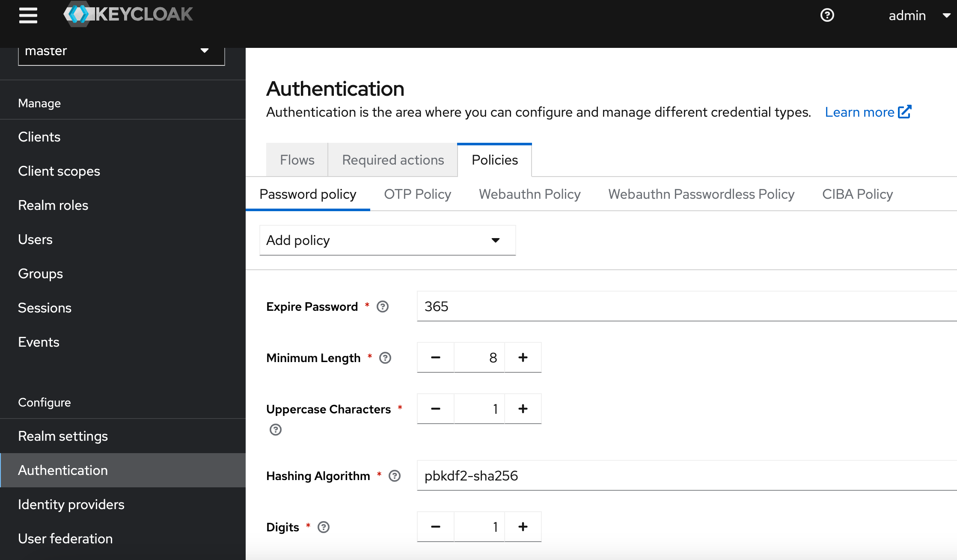
Keycloak Main Features
Password Policy
Authorization
User Management
SSO

Slide 5

Why DaoCloud integrates Keycloak
DX Cloud Native Platform
Other Services
(Web Apps)
……
DX Identity Management
and Authentication Service
OIDC
Full-featured
Professional: Standard Protocols(OIDC,SAML,LDAP,...)
Out of the box, easily deployed on Kubernetes
CNCF Incubating Maturity Level(April, 2023)
Notes:
how our cloud native management system makes full use of the powerful and comprehensive features of Keycloak to implement enterprise-level identity and security access management functions.

Slide 6

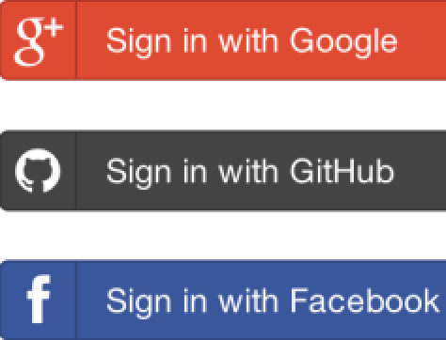


How authentication system uses Keycloak
DX Identity Management and Authentication System
Keycloak Login UI(Custom Theme)
DX UI
DX APIServer
Any
Web App
OIDC
SAML
SSO Client
User Management
Identity Provider
Admin Rest API
SSO Client
User Management
Identity Provider
OIDC
SAML

Slide 7
Customize keycloak functions
Examples
Non-standard OAuth2 Identity Provider
Customize Login Page
Trigger a webhook when a user created event happens

Slide 8
How to customize Identity Provider(1)
External
Identity Provider
Custom
Identity Provider
Plugin
Nonstandard OAuth2
Identity
Providers
Service Provider Interfaces
https://www.keycloak.org/docs/25.0.2/server_development/#_providers

Slide 9
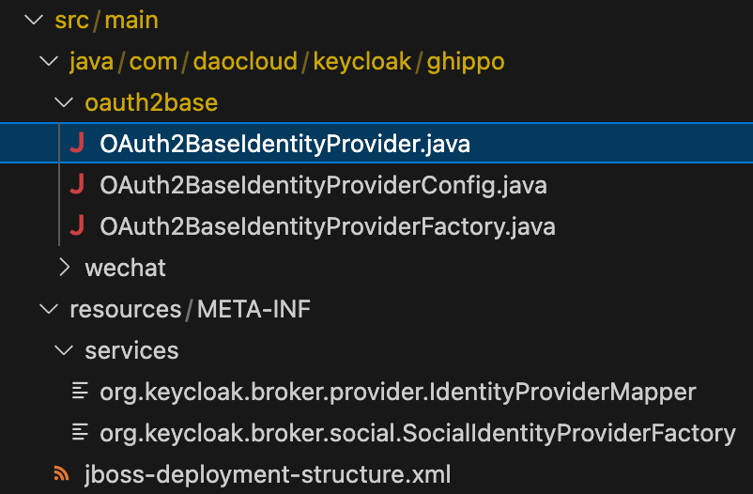
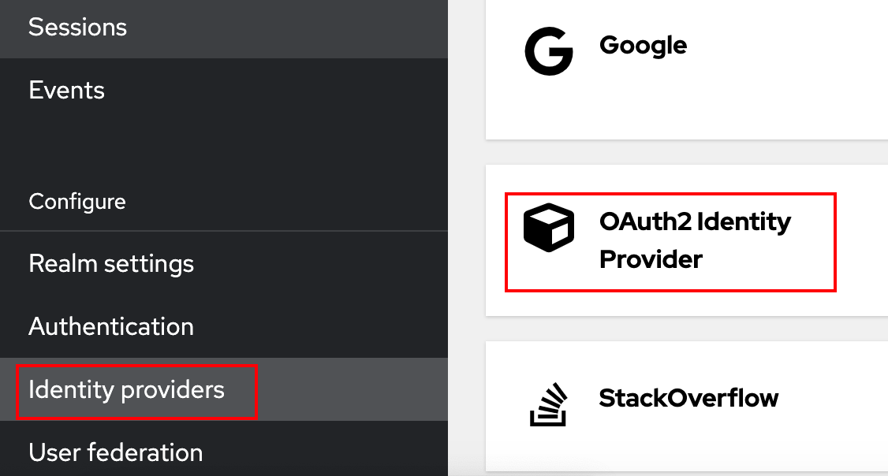
How to customize Identity Provider(2)
Implement SPI
Implement ProviderFactory/Provider interfaces
Create service configuration files
Register plugin
Package .jar(mvn clean package)
Copy .jar file to providers/ directory
Run the kc.[sh|bat] build command

Slide 10
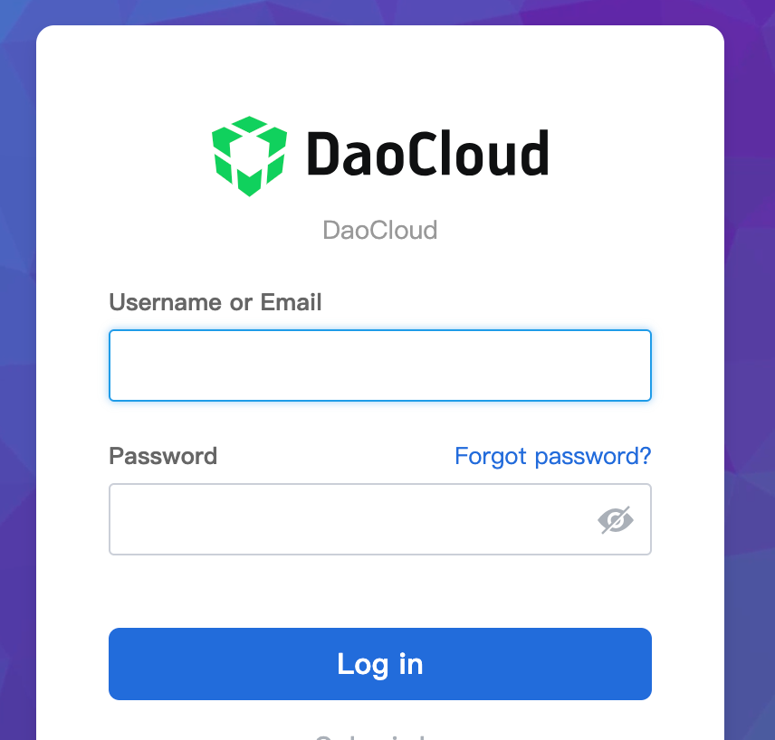
How to customize login page
Customize theme:
https://www.keycloak.org/docs/25.0.2/server_development/#_themes

Slide 11
https://github.com/keycloak/keycloak
https://www.keycloak.org/
Notes:
Accepted to CNCF on April 10, 2023 at the Incubating maturity level.
Security features that developers normally have to write for themselves are provided out of the box by Keycloak.

Slide 12
Thanks
Yiting Jiang, DaoCloud

